Slide 1
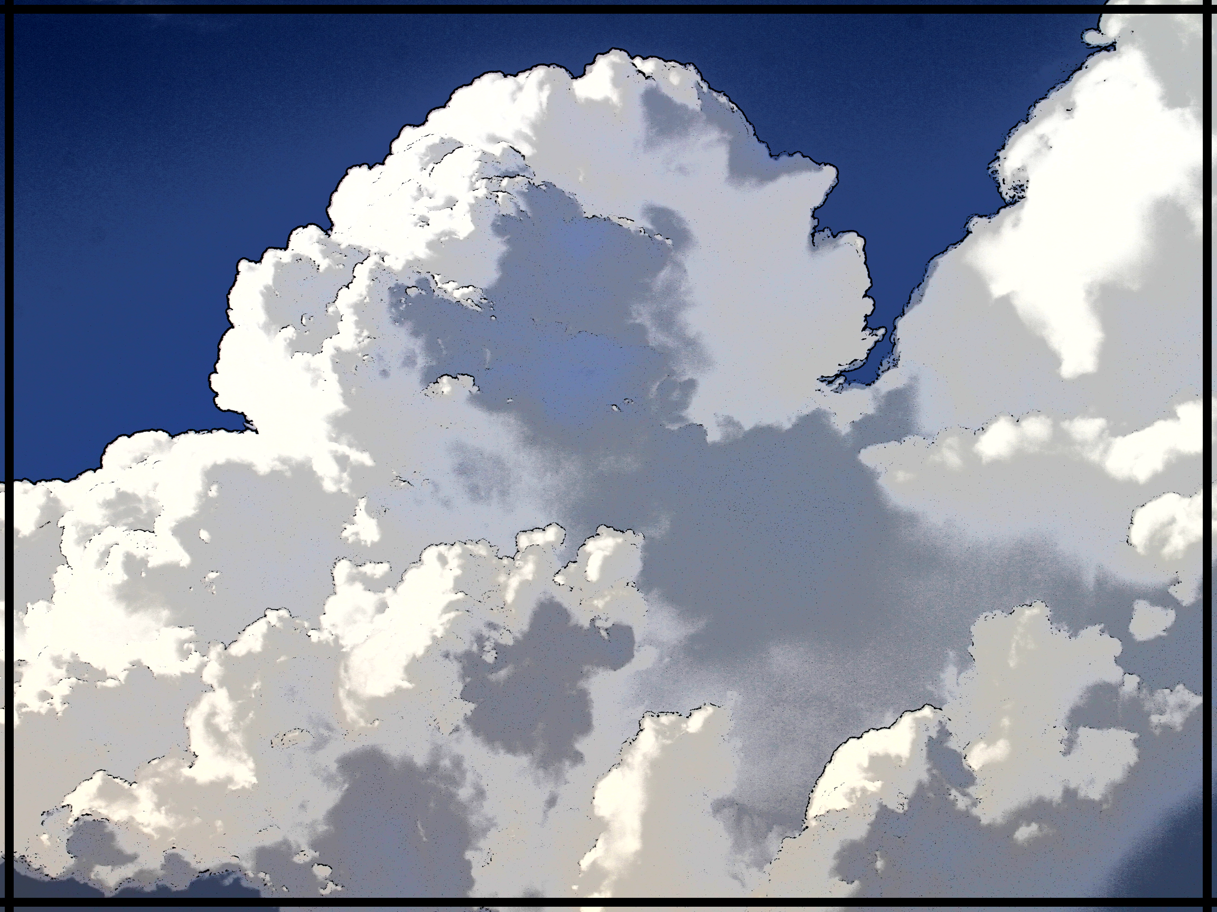
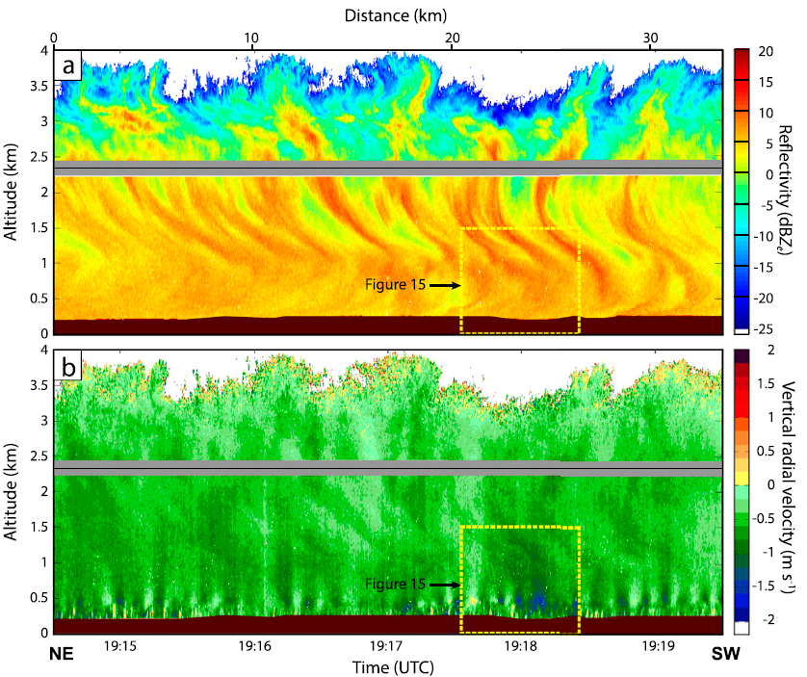
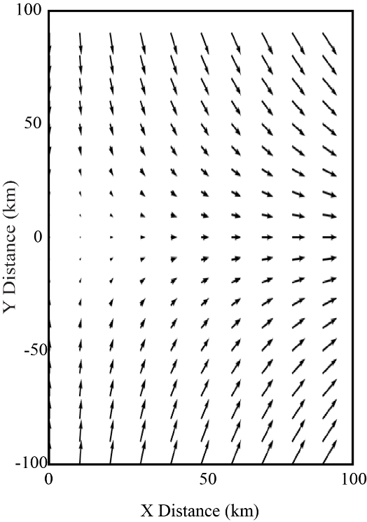
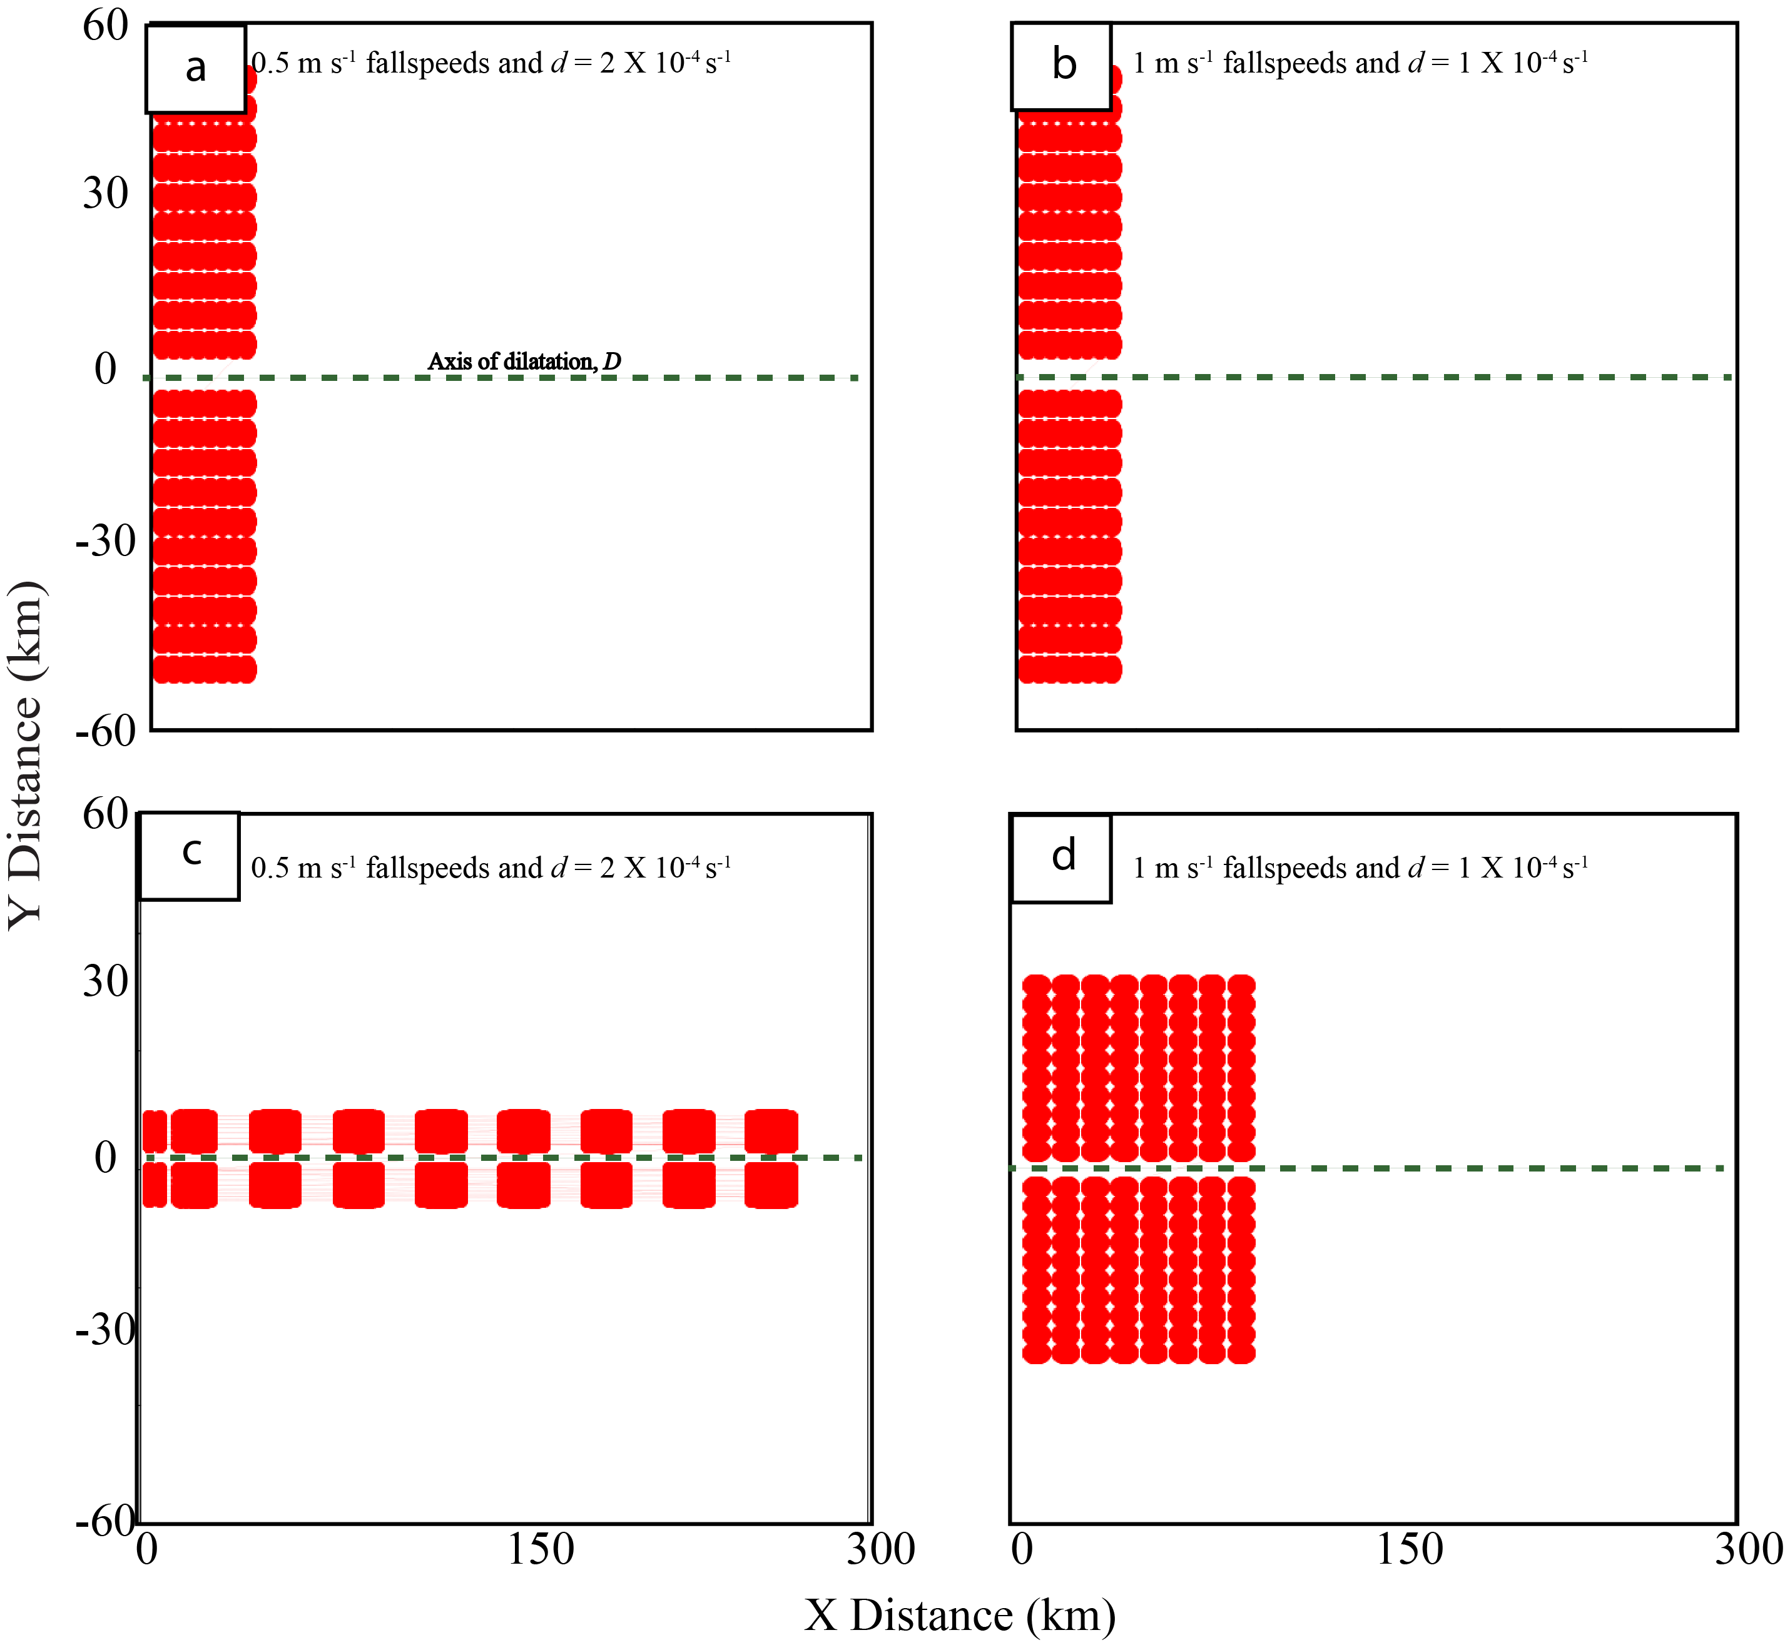
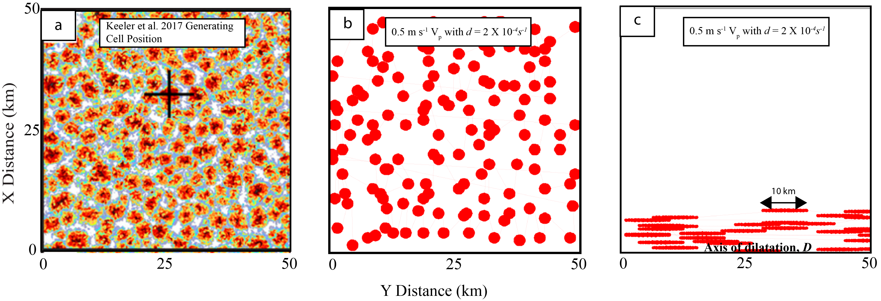
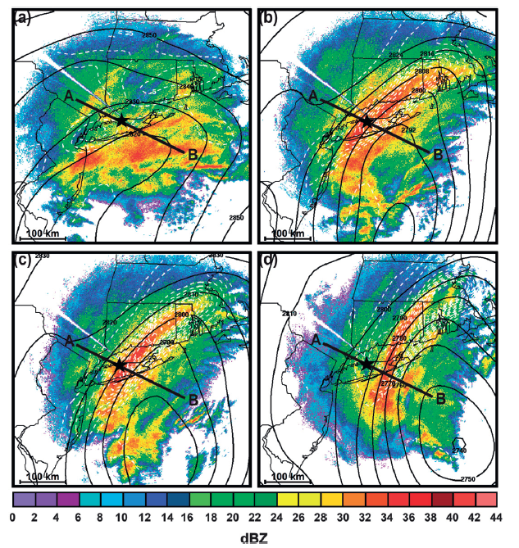
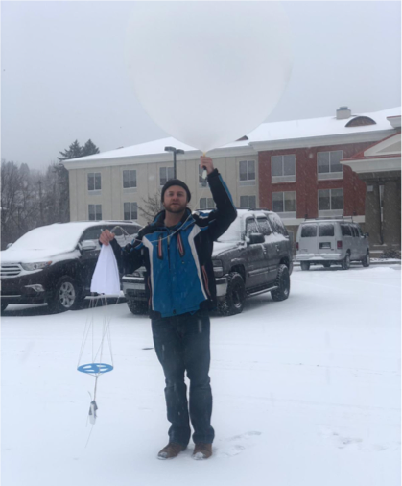
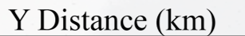
Kinematic Modeling Study of the Vertical Organization of Falling Snow/Ice Particles within a 3-Dimensional Wind Field Andrew Janiszeski, Robert M. Rauber, Brian F. Jewett Department of Atmospheric Sciences, University of Illinois Urbana-Champaign Greg M. McFarquhar CIMMS and School of Meteorology University of Oklahoma
Objectives
This study aims to assess the impacts of environmental winds on distributions of falling snow and ice particles using a kinematic model with a 3-dimensional wind field.
Previous Work
3-Dimensional Winds
Discussion
A
C
Figures D1 and E1 show initial plume position atop the grid for two separate experiments. D2 shows the particle plume placement after falling 10 km through the depth of the grid with V_{p} of 0.5 m s⁻¹ and deformation of 2 x 10⁻⁴ s⁻¹ with E2 showing the same as D2 except for V_{p} of 1 m s⁻¹ and deformation of 1 x 10⁻⁴ s⁻¹. Figure F1 shows a random distribution of particles atop the grid based on an arrangement from Keeler et al. (2017). F2 shows the plume arrangement after falling through the depth of the grid with V_{p} of 0.5 m s⁻¹ and deformation of 2 x 10⁻⁴ s⁻¹. Plumes were stretched the most with the strongest deformation flow and slowest V_{p} resulting in plume merging and stretching along D. This work although limited in scope, supports kinematics being critical in precipitation organization and further work will investigate precisely how important they are.
Methodology
A wind field representative of pure stretching deformation, constant with height, is implemented into the model using a 100 x 200 x 10 km grid in X, Y, and Z respectively. Plumes of particles representing generating cells are placed atop the grid and fall through the depth of the grid. The initial plume arrangements included: plumes in lines parallel to the axis of dilatation (D), lines normal to D, lines diagonal to D, and a random distribution atop the grid. Particle plumes were given a constant fall speed and subject to the environmental winds to determine their impact on the particle plume arrangements.
Presence of cloud top generating cells
Previous work has studied cloud-top generating cells as shown in Fig. A from Rauber et al. (2015) above and linear near-surface banded features as shown in Fig. B below, from Stark et al. (2013). However, little work has been done to show the relationship between the two. This work, while preliminary, attempts to bridge this gap.
The figure above shows the stretching deformation flow in the model. The winds are constant with height for these particular experimental setups.
D1
E1
F1
B
38°, -99°
NASA IMPACTS Project:
D2
E2
F2
Data such as observations of wind and precipitation collected during NASA IMPACTS project are likely
to be incorporated into research.
D2
Photo Credit: Troy Zaremba

